Slide 1
Assignment 9 Screenshots
Katie Hawthorne

Slide 2
Make Classes Abstract
Sample classes made abstract:
TalkingKnightAvatar
TalkingGuardAvatar
AlignedCollection
ChatHistory
Token
And some more I haven’t listed here.

Slide 3
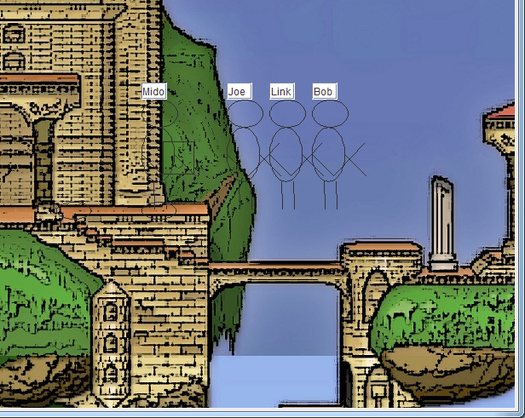
Approaching Knights Move

Slide 4
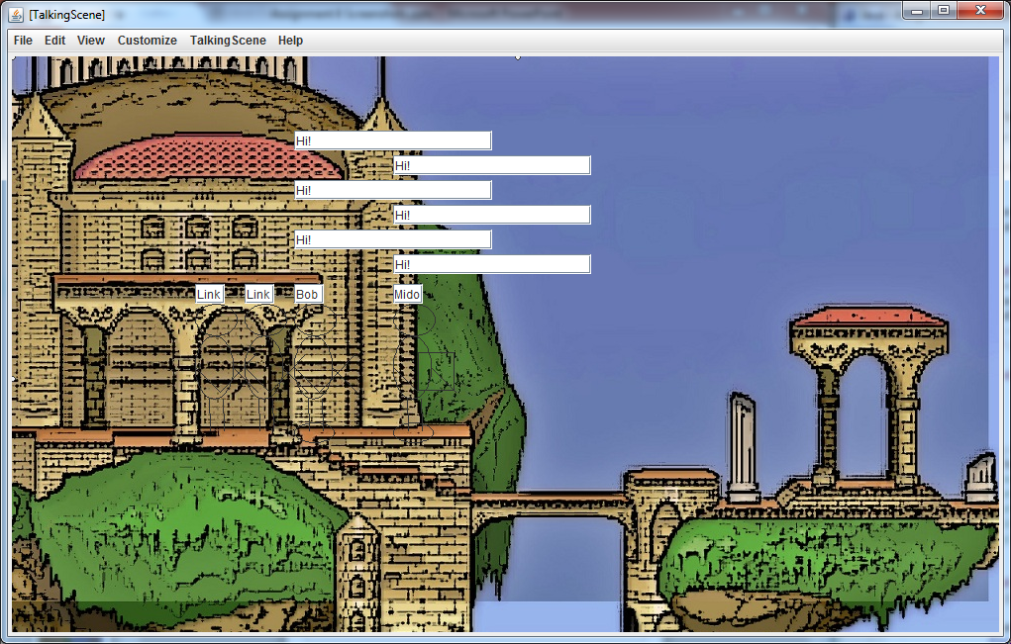
The leading knight and guard alternate speaking.

Slide 5
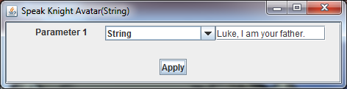
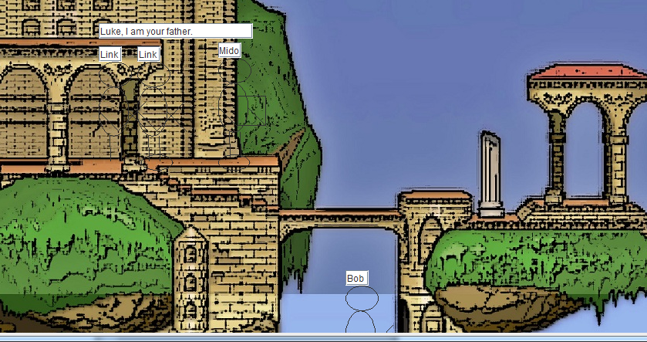
Leading Knight Speaks

Slide 6
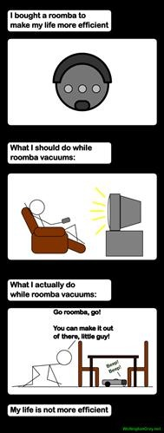
You get bored grading.
I get bored making powerpoints.

Slide 7
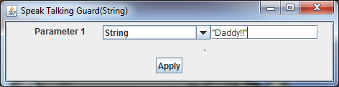
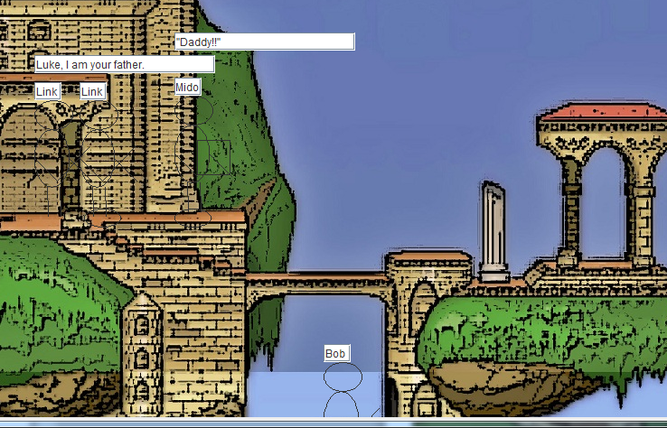
Guard Speaks

Slide 8
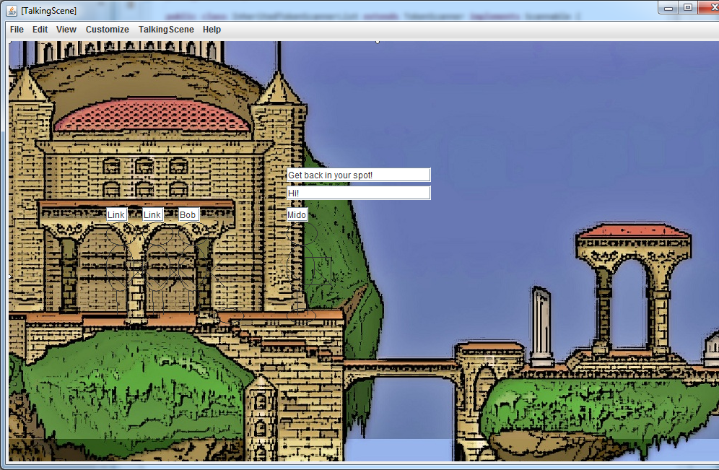
A knight can speak only if it is in the knight standing area.

Slide 9
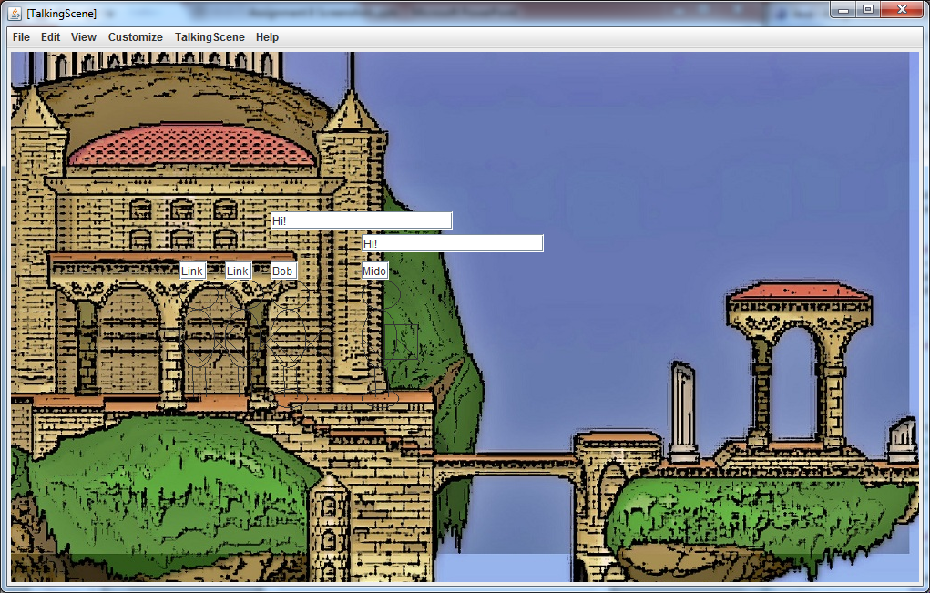

Slide 10
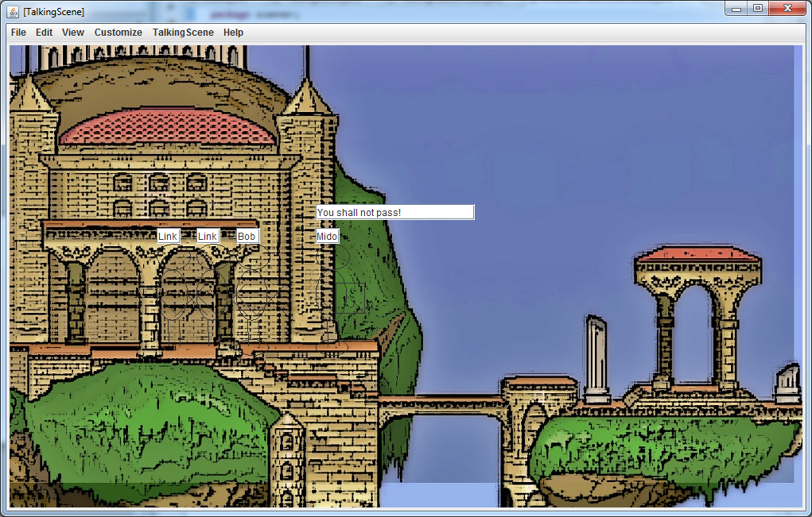
Ensure that the leading knight cannot cross the bridge unless three questions have been answered or the guard has moved away from its standing area.

Slide 11
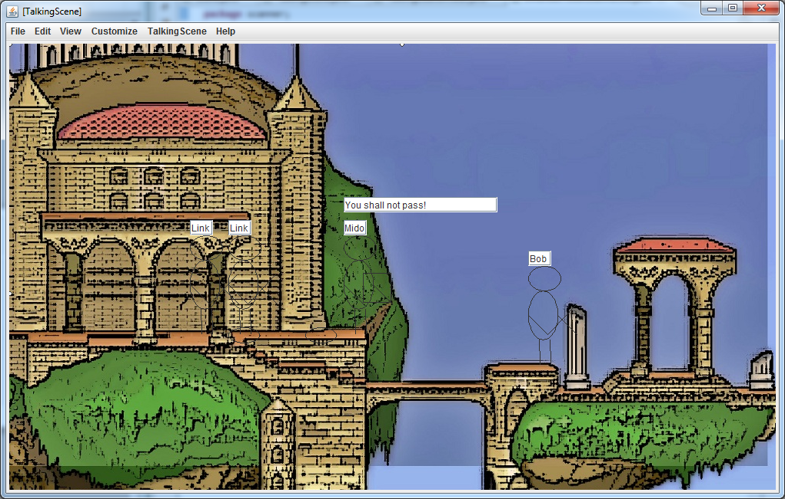

Slide 12
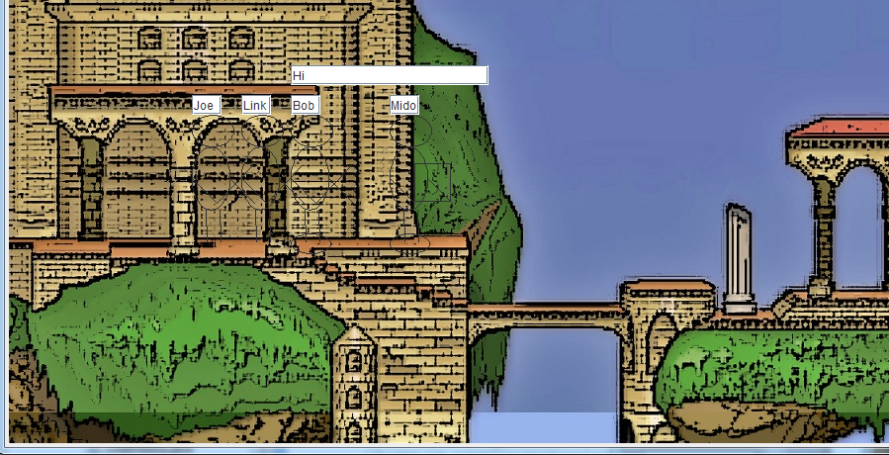
Leading Knight Falls Down

Slide 13
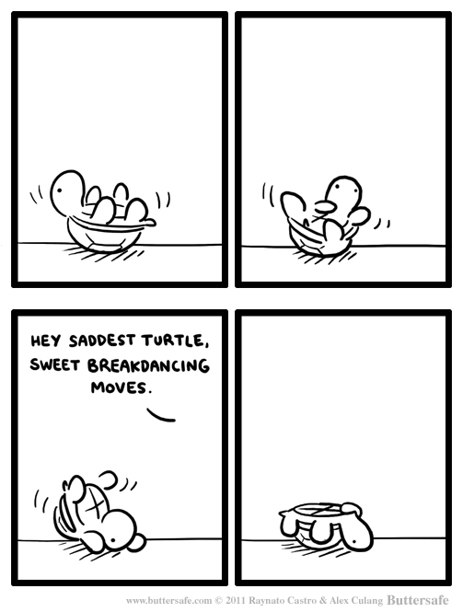

Slide 14
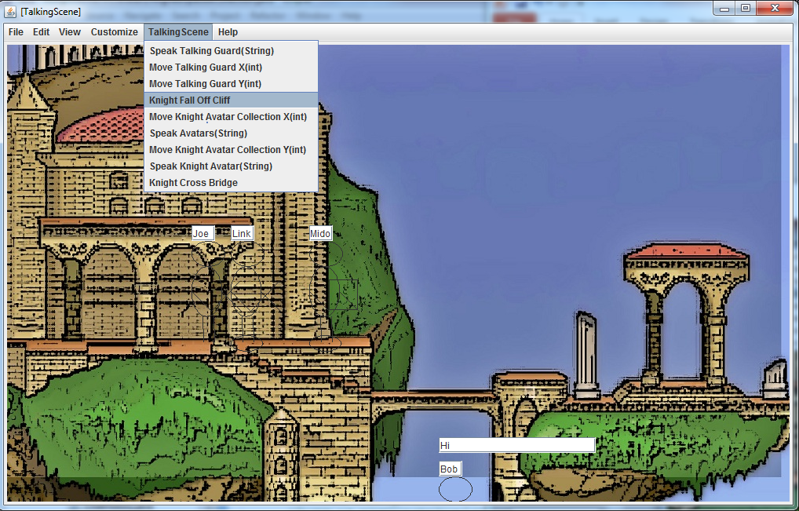

Slide 15
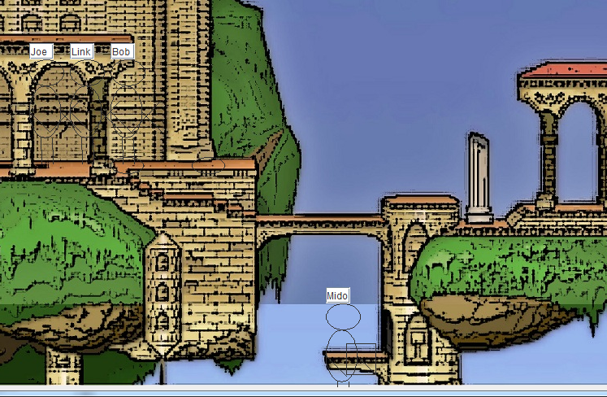
Fail Guard

Slide 16
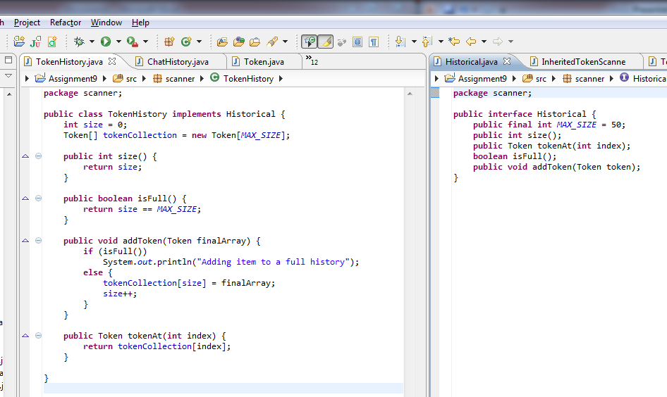
TokenHistory + Interface

Slide 17
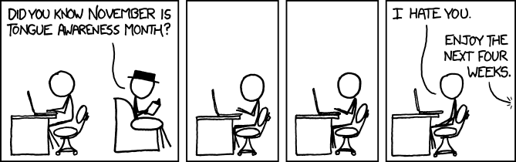

Slide 18
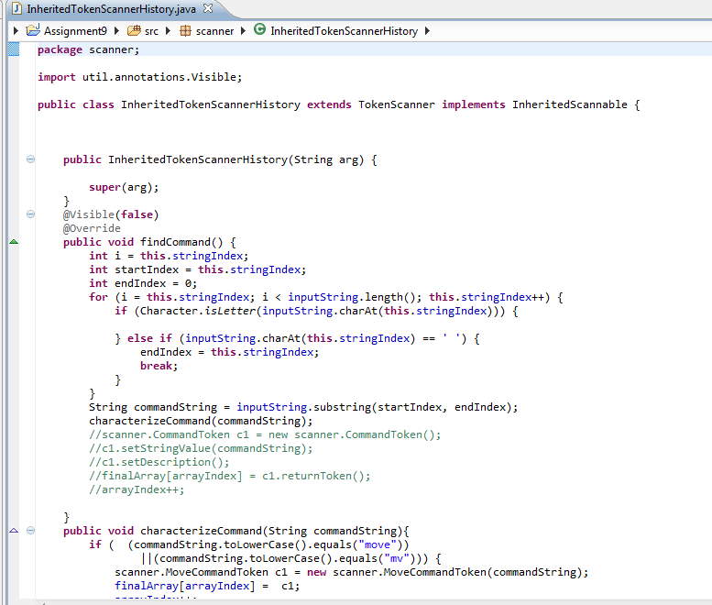
New version of Stateful Scanner Class with instance of Token History (it still inherits from TokenScanner but it does not inherit from InheritableTokenScanner)

Slide 19
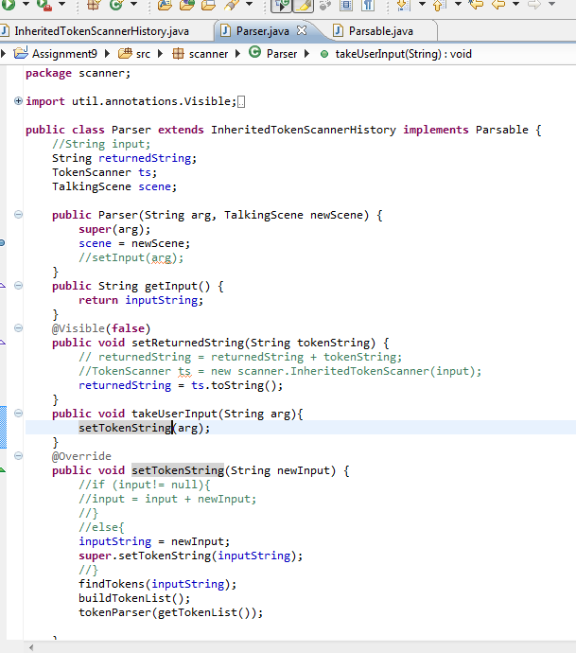
Parser with Scene Object Reference + Overriden Setter Method

Slide 20
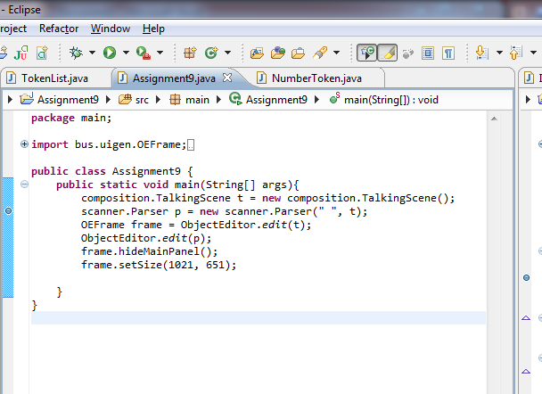
Main method creates and displays an instance of the scene object and an instance of the parser object.

Slide 21
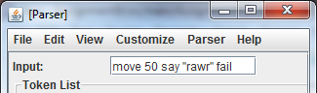
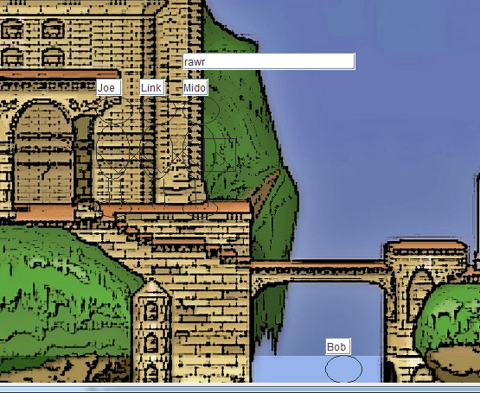
Working Parser – Can enter multiple commands (Scene upon Refresh)

Slide 22
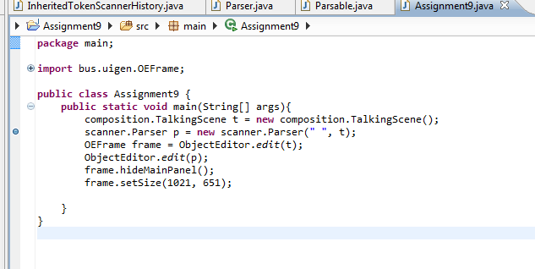
Main method opens instance of parser + instance of scene

Slide 23
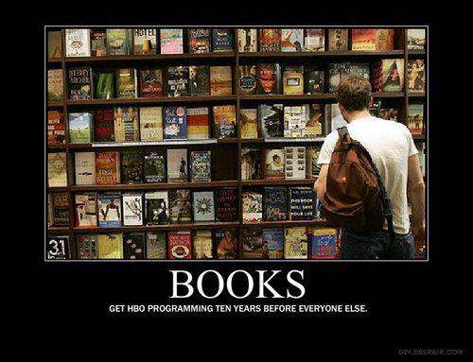

Slide 24
Extra Credit
Turn in Wednesday
Reuse code from previous scanner --code in InheritedTokenScanner and InheritedTokenScannerHistory are very similar. I added some stuff, but I just copied and pasted the code. I may have interpreted this wrong though
Parse +/- Token (see screenshot)

Slide 25
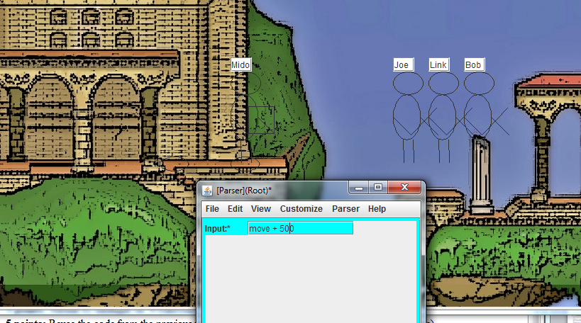
+/- Token Parsed

Slide 26
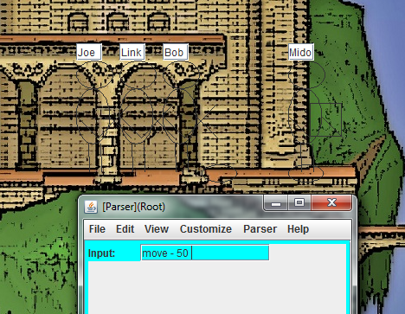
- token

Slide 27
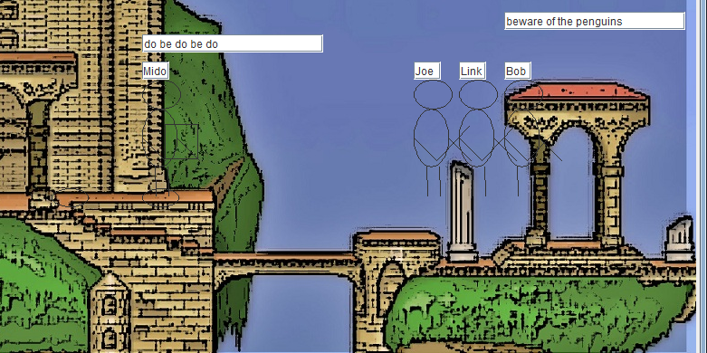
Enter multiple commands input : say "do be do be do" say "beware of the penguins" move 500

Slide 28
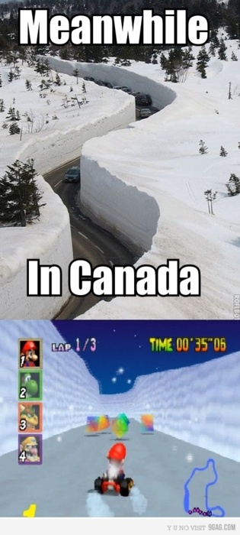
Thus concludes our regularly scheduled screenshots.

